Slide 1
Data Science Project Finding suitable locations to open a car wash in London, UK
February 2021

Slide 2
Task: find a suitable location for a new car wash in London, UK
Three objectives:
Find an area that isn’t too crowded with competition
Has a decent amount of passing volume of traffic
Has a relatively sizeable amount of population

Slide 3
Data
Scraping London borough data
Obtaining Location of existing competition through Foursquare API
Supporting information, such as vehicle traffic volume of each borough

Slide 4
Methodology
K-means clustering is going to be used to help group car wash locations and analyse the best potential candidate.
In order to define the right k, Elbow Method is going to be used by plotting the variance as a function of the number of clusters and picking the k that flattens the curve.
The main open source Python libraries that are used are the following:
Data Analysis and Manipulation
Pandas
SciPy
NumPy
Data Visualisation
Matplotlib
Seaborn
Folium
Machine Learning
Scikit-Learn

Slide 5
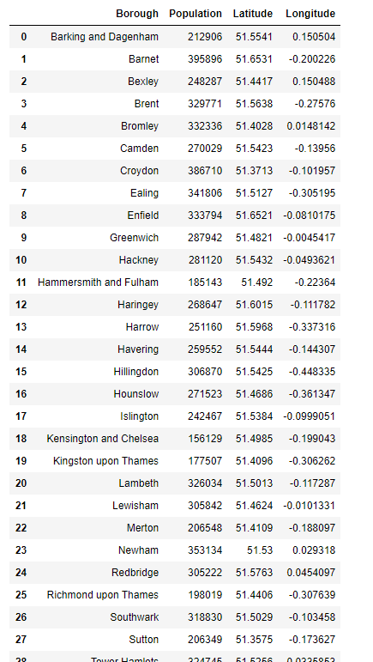
Final Borough List

Slide 6
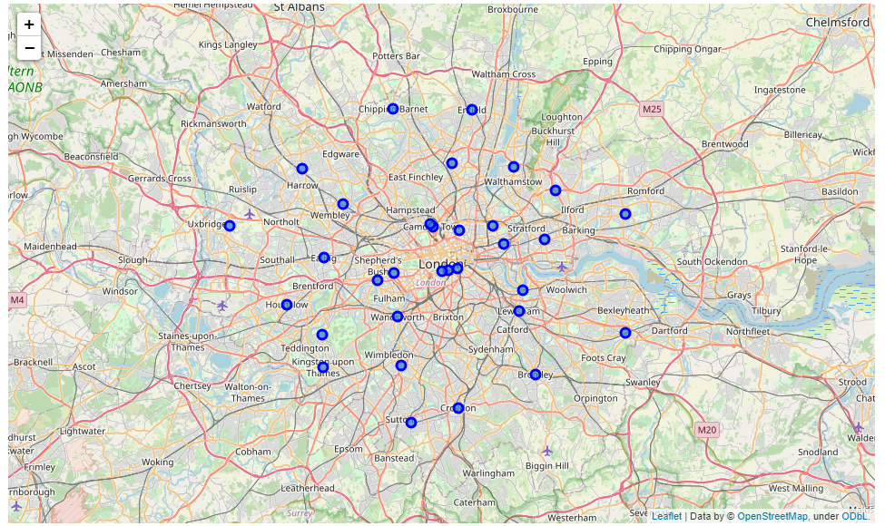
Boroughs plotted in Folium

Slide 7
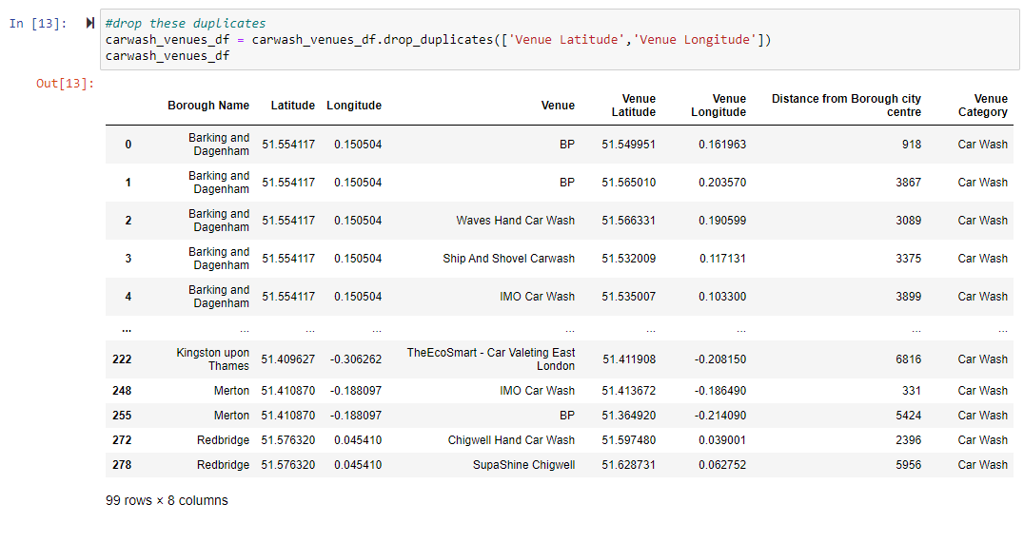
Extracted competition from Foursquare

Slide 8
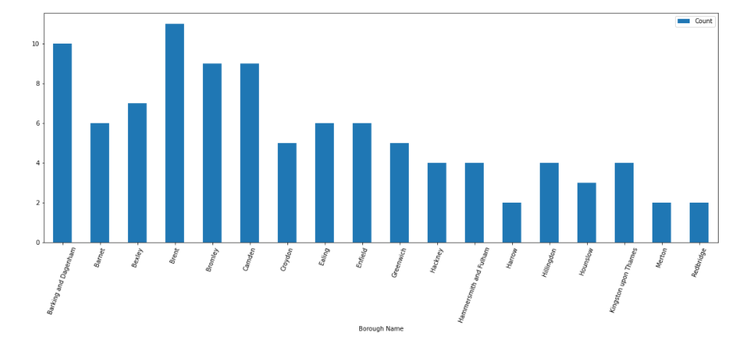
Existing Car Washes per Borough

Slide 9
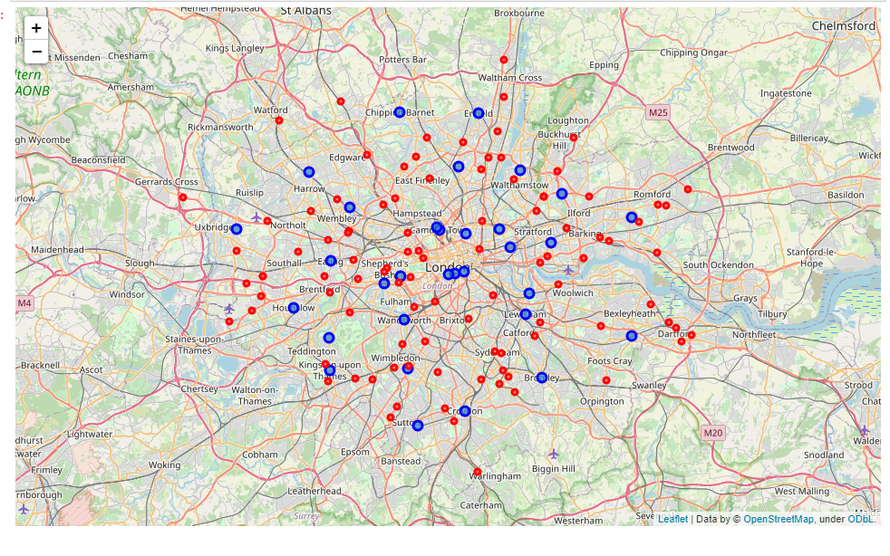
Existing Car Washes plotted in Folium

Slide 10
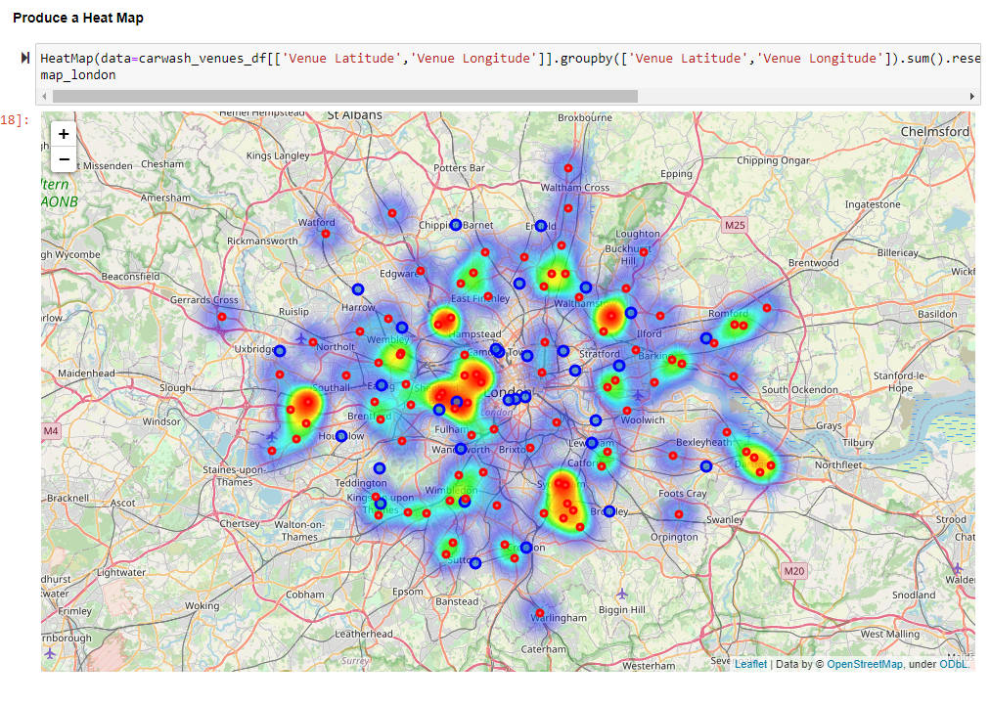
Heatmap in Folium

Slide 11
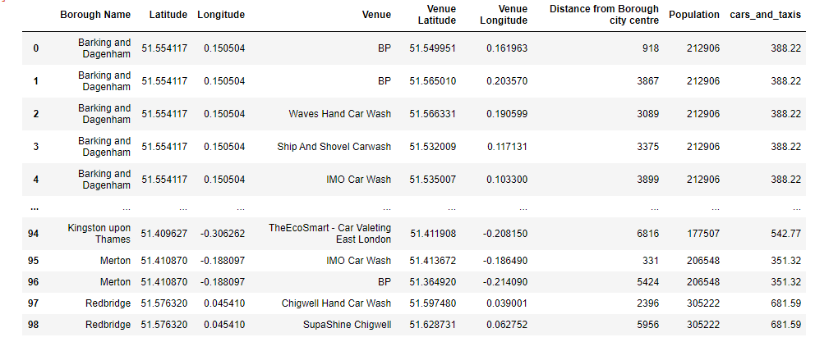
Final Table for Analysis with Traffic Volume

Slide 12
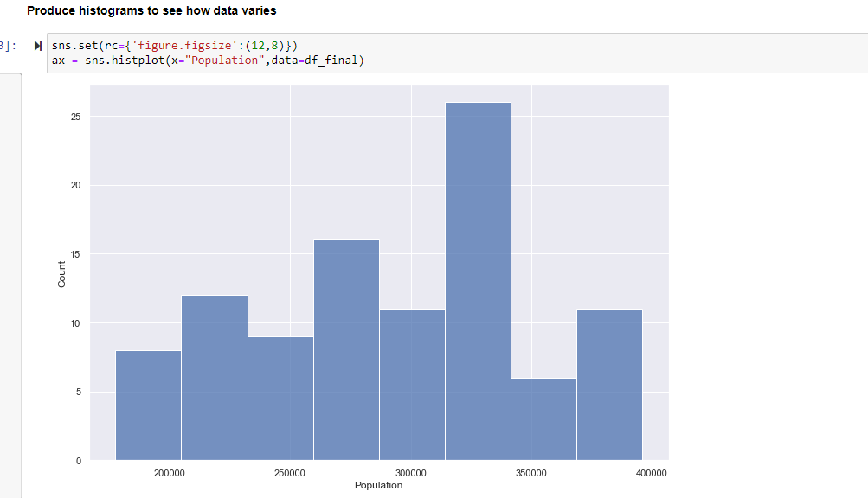
Examine the variables

Slide 13
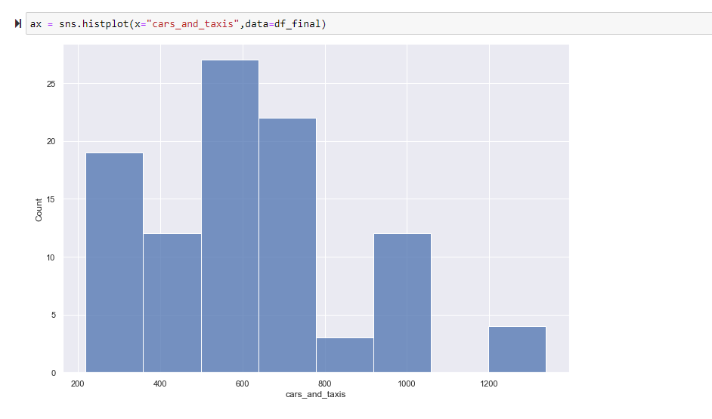
Examine the variables (cont‘d)

Slide 14
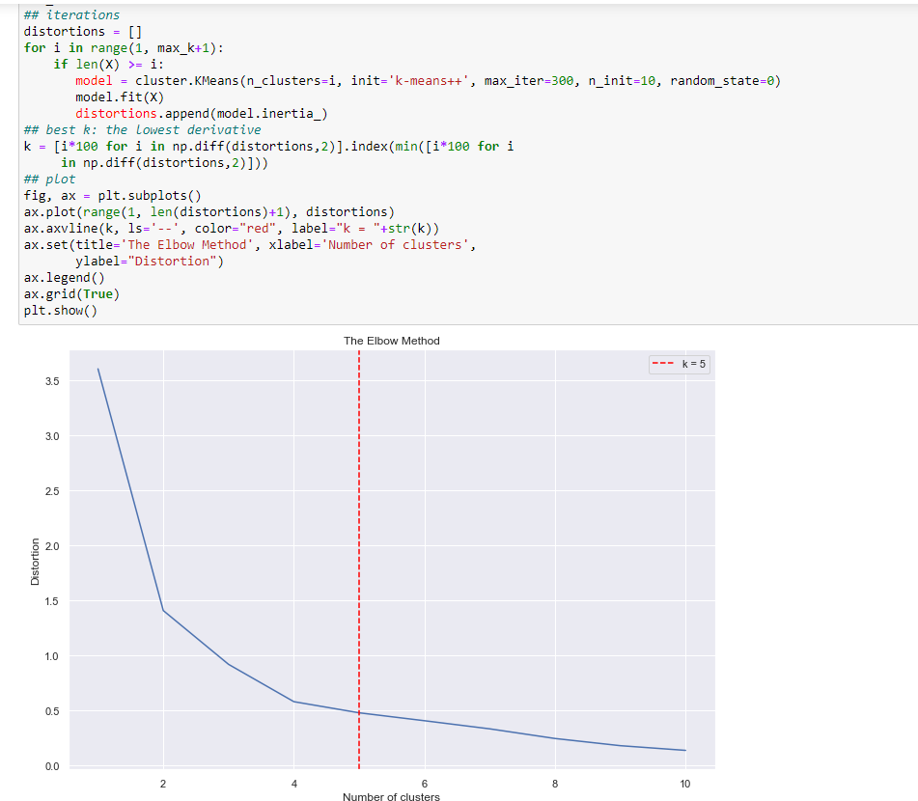
K-means Clustering & Elbow Method

Slide 15
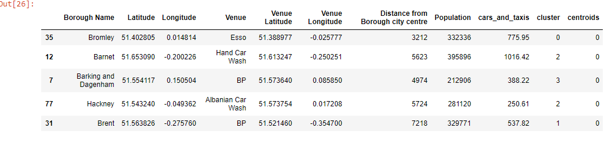
Data with Clusters and Centroids

Slide 16
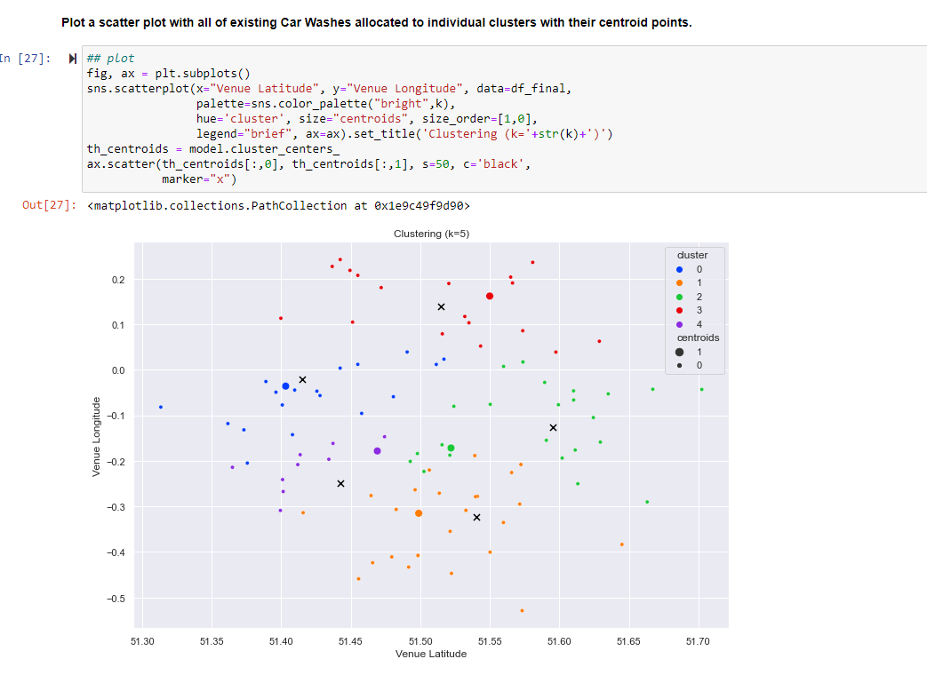
Cluster Scatterplot

Slide 17
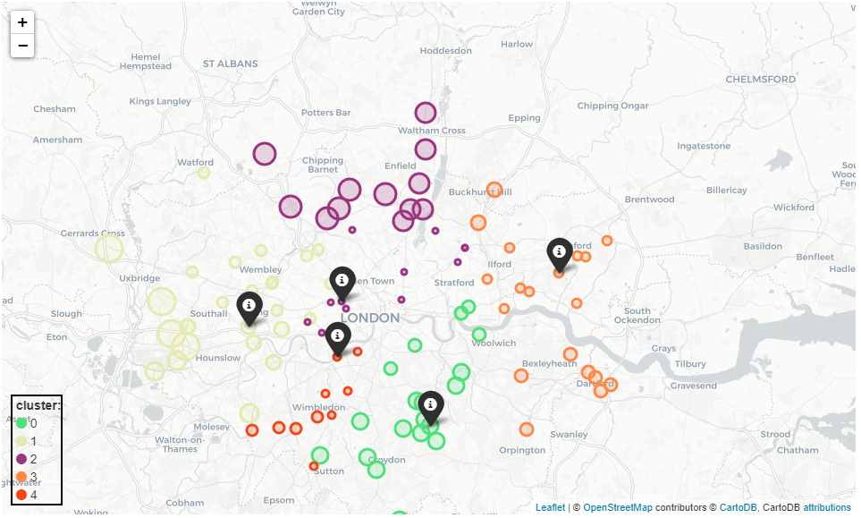
Clusters plotted in Folium

Slide 18
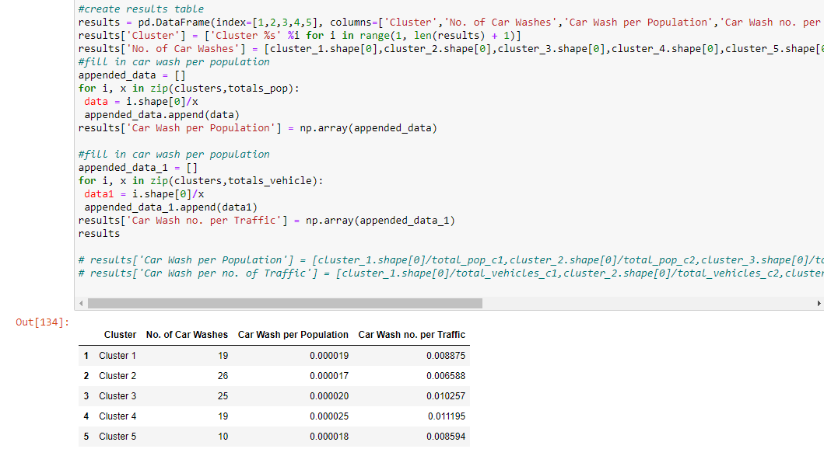
Results

Slide 19
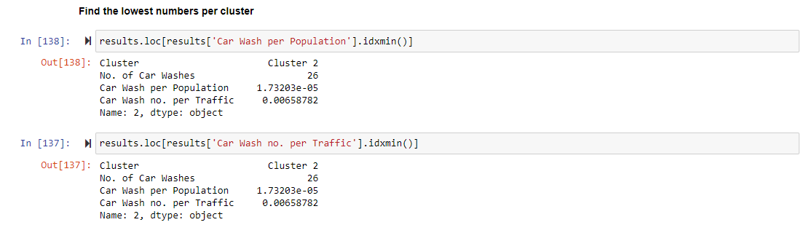
Results (cont’d)
Cluster 2 – West London – is the best area

Slide 20
Results (cont’d)
Cluster no.2 has the lowest number of car wash facilities per population and traffic volume, despite having the highest number of Car Washes. Therefore, for a potential investor starting a new venture this area would be highly desirable. The Boroughs include:
Brent
Harrow
Ealing
Hillingdon
Indeed, this area benefits from dense population and high amount of vehicle traffic, for example due to Heathrow Airport, therefore it is an attractive location. Further analysis could benefit incorporating a cost consideration i.e. the optimum location from a financial point of view.

